Slide 1


DASI: Business Analytics Alumni Survey
Kellie Keeling and Scott Toney
DSI, Atlanta, GA, November 20, 2023
bit.ly/KKPresentationFiles
Notes:
DSI ABSTRACT -

Slide 2
Motivation
We are examining what careers/jobs that students are getting after leaving our program.
We are determining what changes should be made to our curriculum for our BSBA in Business Analytics and MS BA.
Our BSBA in Business Analytics had its first graduates in 2016. The only major change to the curriculum is the addition of Python.
Our MSBA has undergone a number of changes since 2013 including the addition of a cloud computing class and updates to our capstone.
bit.ly/KKPresentationFiles
Notes:
(

Slide 3
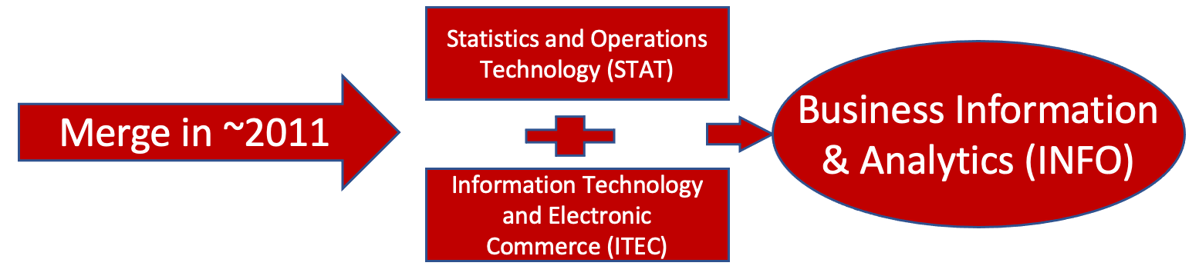
History
First MSBA Graduates Summer 2013
(Previous MS Business Intelligence, MS Data Mining)
First BSBA Business Analytics Majors Spring 2016
(Previous Statistics Major, Information Technology Major)

Slide 4







BSBA in Business Analytics
Data Mining and Visualization
(JMP, Tableau)
Data Ware and BI
(SQL Server BI: SSMS/IS/AS, PowerPivot, OLTP to OLAP; PowerBI, Azure)
Automating Business Processes
(Excel VBA, Python)
3200
3100
3300
Found of Info Management
(Access, Visio)
Complex Data Analytics (Text/Network)
(Python, Alteryx, NodeXL)
3140
3400
Project Management and Simulation
3340
Enterprise Info Mgmt
(Visio, SQL Server OLTP, Visual Studio, Azure)
3240
Optimization
(Excel)
Capstone Project
3440
3500
C# behind forms
2 Electives
ELECTIVES:
Analytics Careers
Sports Analytics
Nonparametric Statistics
Past: Database Driven Websites
MINOR: 3100 Aut Bus (Program.), 3140 Found IS (DB1) + 2 more classes

Slide 5





MS in Business Analytics
Classes added since 2013– Python, Intro to Business,
Complex Data Analytics (Text Mining), Big Data Platforms
1. F/Sp
Python
Programming
Survey of Business Analytics
(Tableau, Visio, PowerBI)
Business Statistics
(Excel)
Business Databases
(SQL Server, Visio)
4120
4100
4610
4140
4200
Capstone Planning:2
Data Warehousing
(SQL Server: SSIS/AS, SSMS/RS, PowerPivot, PowerBI)
Introduction to Business
Optimization
(Excel)
4240
2. W/Su
4000
4590
4281
Project Management:2
(Crystal Ball)
Complex Data
Analytics (Text Mining)
Predictive Analytics
(SPSS Modeler, Python)
Big Data Platforms
Hadoop, AWS, MS Azure
Data Mining and Visualization
(Tableau)
4360
4300
4260
3. F/Sp
4340
Decision
Processes: 2
Adv Predictive Modeling with R
Capstone
Project
4381
4390
4200
4. W/Su

Slide 6

How Do We Tell if Students are Satisfied
Graduate surveys
Listening Sessions
Salary and outcome data
But what do fresh grads know?

Slide 7
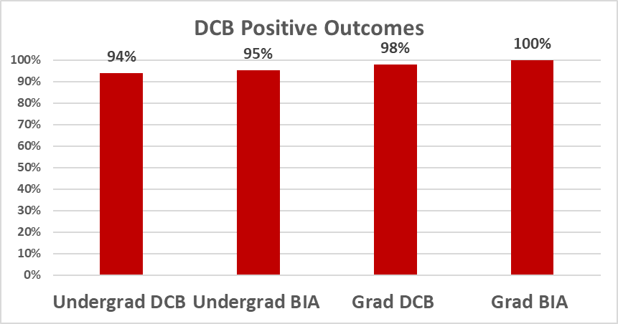
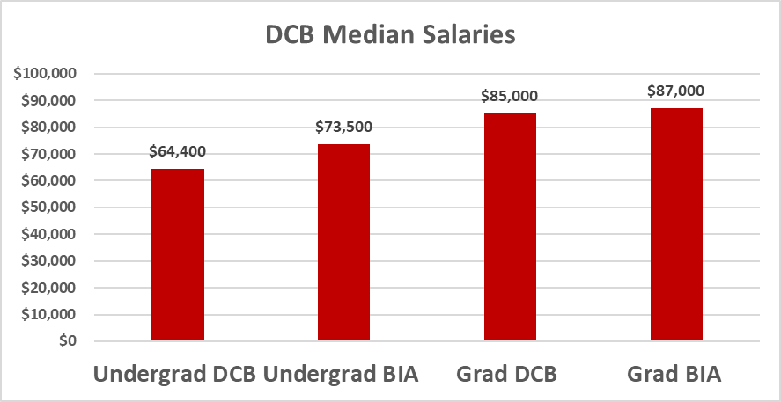
Hiring Outcomes 2022

Slide 8
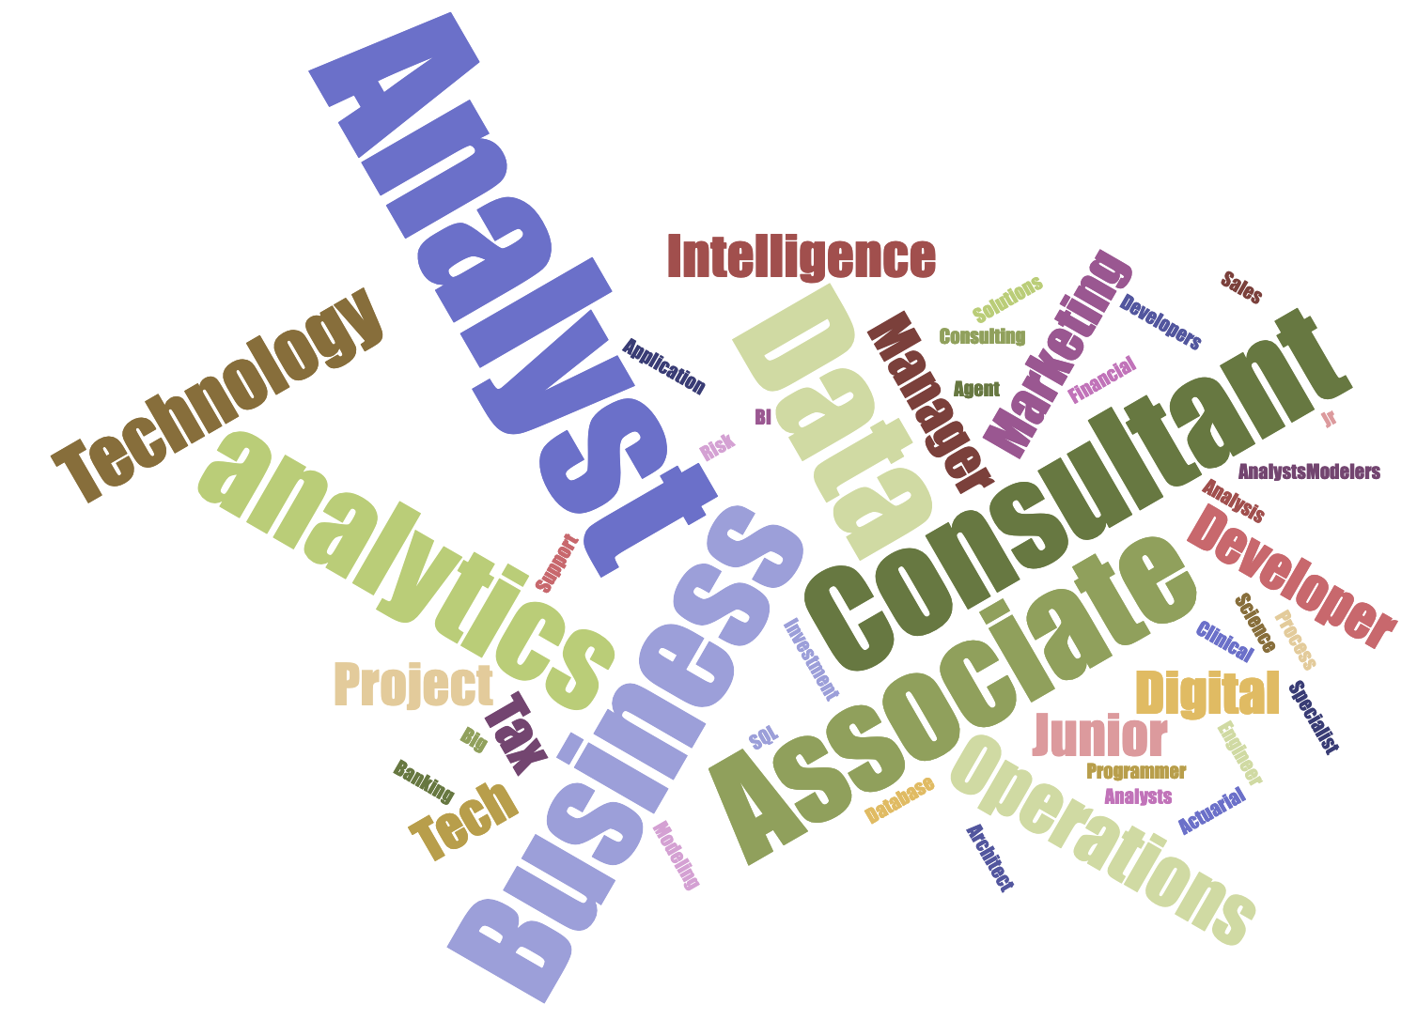
BSBA Exit Survey (First Jobs)
Notes:
2023: Business Analyst, Financial Analyst, Operations Analyst, Business Analyst, Tech Risk Consultant, Data and Analytics Associate, Business Analytics Consultant.
2022: Business Analyst, Data analyst, digital analytics specialist, Associate IT Project Manager, Technology Architect, Clinical Data Analyst, SQL Agent,
2021: Analyst, Consulting Analyst, Technology Consultant, Project Manager, Data Analyst, Business Intelligence Developer, Associate Analytics Analyst
2020: Business Analyst, Solutions Engineer, Data Science Analyst, Junior Data Analyst, Data & Analytics Associate, Tech Consultant, Programmer, Associate Database Consultant
2019: Business process analyst, Analytics Associate consultant, Junior analyst, Data & analytics associate, Business analyst, Consultant, Sales operations analyst
2018: Business Analyst, Consultant, Digital Analyst, Tax Associate, Marketing Analysis, Operations Support Analyst, Jr. Analyst, Business Intelligence Developer
2017:Data Analysts/Modelers, BI Analysts, Modeling, Application Developers
2016: Actuarial Analyst, Associate in Tax Technology, Data Analyst, IT Analyst, Investment Banking Analyst, Big Data Analyst, Business Analyst, Consultant, Marketing Analyst

Slide 9
What Else Could We Want to Know?
Are students getting and keeping the jobs we think they are?
Do the students feel well prepared?
Are they well prepared because of the curricular choices we have made?
Are there things we could change?

Slide 10

Survey Work
What is in the survey?
How did we get respondents?
What did the survey tell us?

Slide 11
What is in the survey
12 questions
Demographics – When did you graduate and what is your current title?
Other titles – past, future
Skills used – over career and in last 6 months
Content – What was good and what could be improved

Slide 12

How did we get Respondents
This is the hard part
Alumni Emails
Future?
LinkedIn
Word of Mouth

Slide 13
Responses
Undergrad – 20
Graduate – 14
What did the populations look like? 50 or so for each year now, for each level (it grew over several years)
We ended up getting more than a single year's worth
7 years of undergrads, 9 years of grads

Slide 14
What did the students say
Sooooo Much
Lots of answers about what we taught and what they needed
Not such a clear picture from the free response section

Slide 15
Job Titles
What kinds of job titles do the students hold after 5 years?
What other job titles have they held along the way?
Do these align with our expectations?

Slide 16
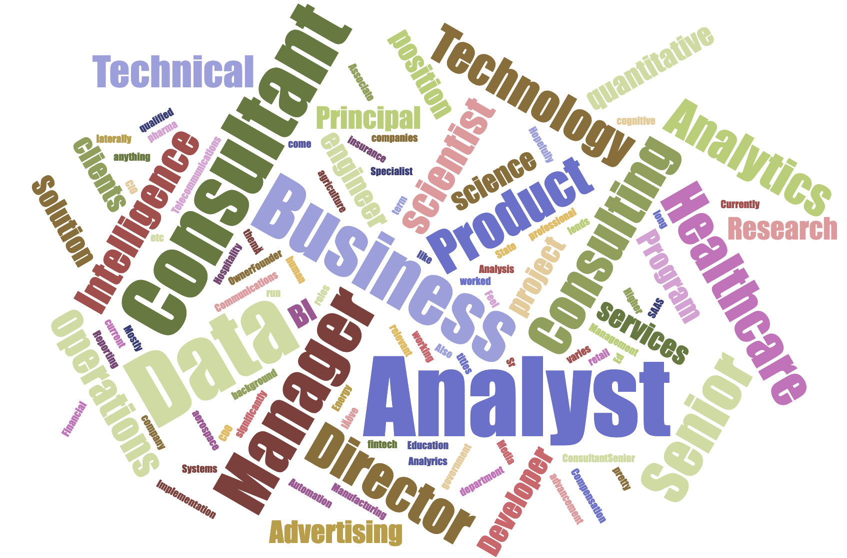
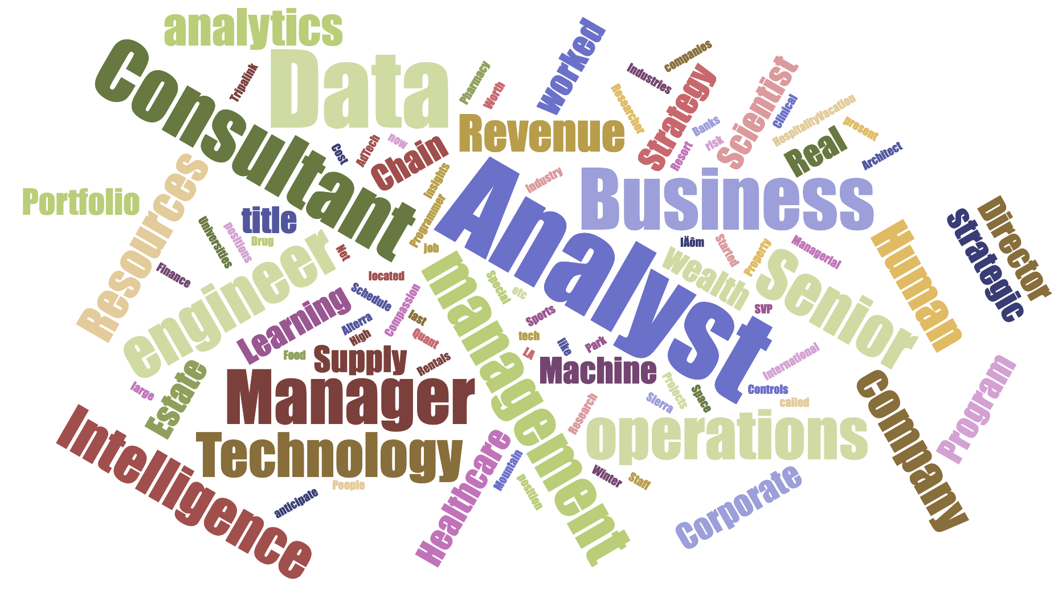
Job Titles/Industries
GRADUATE UNDERGRADUATE
Notes:
Job titles have or qualified for
BSBA
Programmer Analyst
Supply chain analyst, risk management
Business Analyst
Data and Insights Analyst
Consultant
Strategy & Operations analyst
Data Researcher, Data Analyst, Data Scientist, Machine Learning Engineer
Hospitality/Vacation Rentals, AdTech
Quant Research Analyst, Data Engineer. Industries: Healthcare, Sports
Technology consultant
Data analyst
Business Intelligence Analyst - Compassion International
Program Cost, Schedule & Controls Analyst - Sierra Space
Supply Chain Data Analyst
Pharmacy Data Consultant
Special Projects Strategic Operations Analyst
Senior Clinical Operations Analyst
My last job I have the title Data Analyst. I have been worked in Property Management company called Tripalink located in LA.
Started as Data Analyst at Winter Park Resort and now I‚Äôm a Senior Revenue Analyst at Alterra Mountain Company.
Business Intelligence Consultant worked with Banks, Universities, Food and Drug, Healthcare, etc. companies
Staff Technology Consultant, Senior Technology Consultant (present)
People Analyst (Human Resources)
Business Intelligence Analyst (Human Resources)
Analytics Engineer (Human Resources)
Analytics Program Manager (Corporate Real Estate)
Business Analyst (Corporate Real Estate)
large tech company
Portfolio Manager- High Net Worth Wealth Management
Industry: Finance
Strategy & Operations Manager - SVP
Data Analyst, Data Scientist, Machine Learning Engineer
Director
Data analyst
Data engineer
Business analyst
Managerial positions for strategic operations
I anticipate title like Business Analyst or Data Analyst.
Manager of revenue analytics
Director of Revenue Management
Senior Business Intelligence Consultant, Architect
Technology Consultant Manager
Senior Portfolio Manager
Any other wealth management position
MSBA
Consultant, senior consultant, professional services consultant, data scientist, data analyst, cognitive engineer
most of them‚Ä¶ consulting varies significantly from project to project with clients. I‚Äôve had clients in healthcare, insurance, aerospace, retail, pharma, etc.
Mostly consulting, which come with the relevant titles (consultant, senior consultant, principal consultant). Also worked as a product manager in a fintech company.
BI Developer in Healthcare
Business Analyst in Higher Ed
Consultant/Senior Consultant, Analyst
Owner/Founder, Energy Specialist
Senior Product Manager
Research Analysis & Data Manager
Senior Data Analyst
Data Analyst
State government, human services
Data analyst, Quantitative analyst
consulting, agriculture
Consultant, Sr Consultant, Principal
Consulting (Media & Communications, Healthcare, Hospitality, Manufacturing)
Business Analyst, Data Analyst, Senior Data Analyst (current position). Telecommunications and SAAS.
Analytics Manager, Business Analyst, Business Intelligence Analyst, Data Analyst
Consulting, Financial Operations
Education
Compensation Analyst
BI Developer
Senior Business Analyst - Healthcare Technology
Solution Consultant - Healthcare Technology
Technical Solution Consultant - Advertising Technology
Technical Program Manager - Advertising Technology
Hopefully anything! My background lends itself to consultant roles and business analyst pretty laterally.
Director of analytics
Director of data science
Data Analyst, Business Analyst
CDO, CIO
Business Analyst, Data analyst, Product Manager, Product Associate, Data Systems analyst, Data Scientist, Business intelligence analyst
Operations Director
Data analyst, data scientist, data engineer, quantitative analyst
Director of Analytics
Currently working for advancement to manager of Analytics. Would like to run our companies Business Intelligence, Reporting, and Automation department. Feel qualified for any data science or analyst position.
Operations Research
Director of Analyrics - long term
Business Analyst, Technical Program Management, Implementation Consultant, Product Manager, Data Analyst

Slide 17
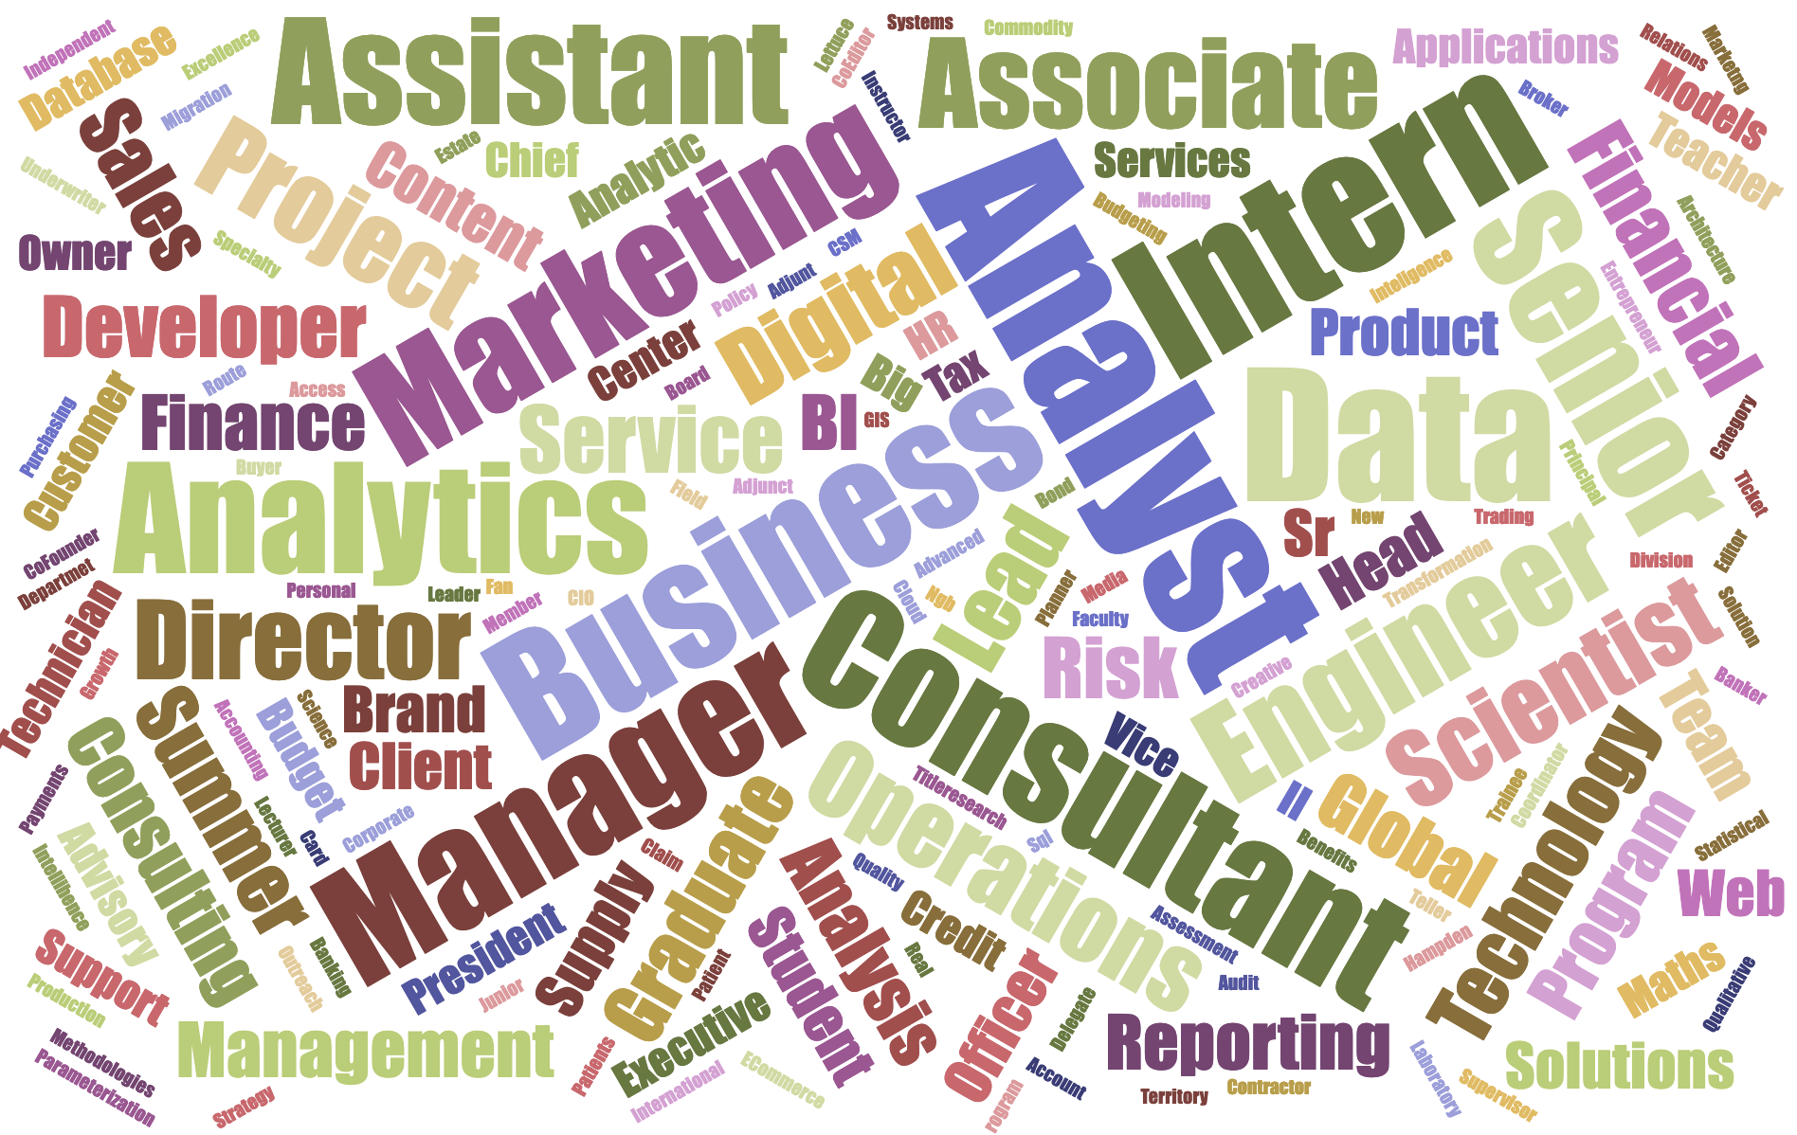
LinkedIn Pages of MSBA Alumni
Job Titles (past or qualified for)

Slide 18
Current Job Category
Undergraduate |  |  | Graduate
Business Analyst | 24.14% |  | Business Analyst | 28.00%
Data Scientist | 20.69% |  | Data Scientist | 16.00%
Business Intelligence Analyst | 27.59% |  | Business Intelligence Analyst | 28.00%
Data Analyst | 27.59% |  | Data Analyst | 28.00
Undergrad: “I think through experience in other areas of business or taking supplemental certifications I can qualify myself for any title I want.”

Slide 19
Useful Skills and Software
What software have students used in their career
What have they used recently?
What of these have we prepared them for specifically?
What could we do better in their prep?

Slide 20
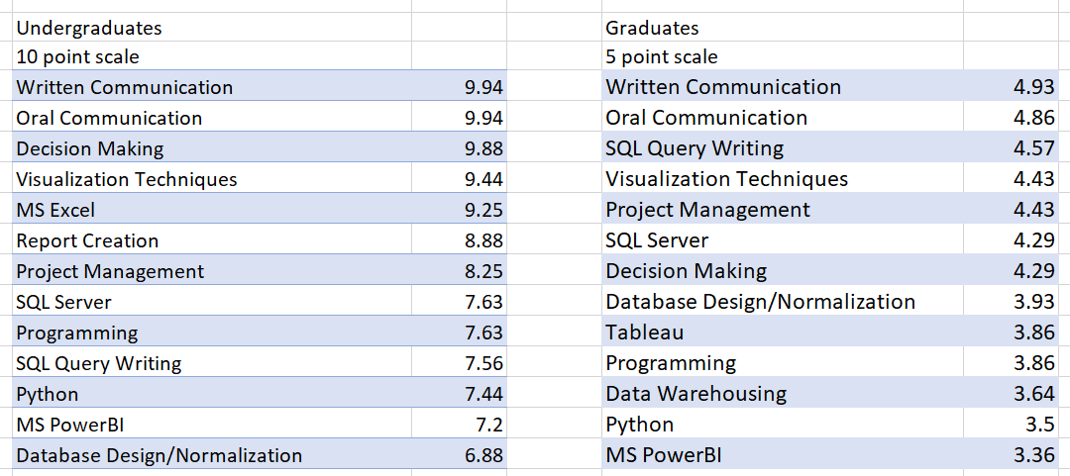
Top Skills/Software for Undergrads and Grads

Slide 21
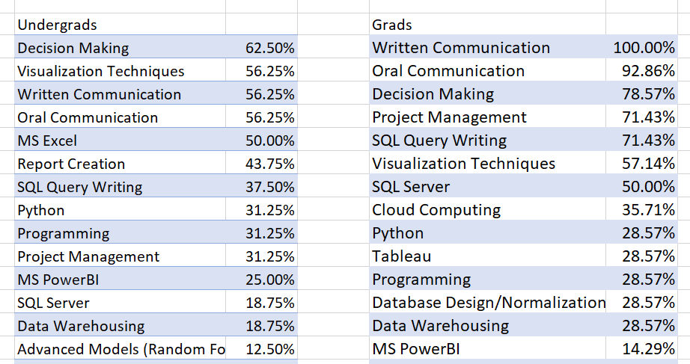
Used Weekly In the Last 6 Months – Top

Slide 22
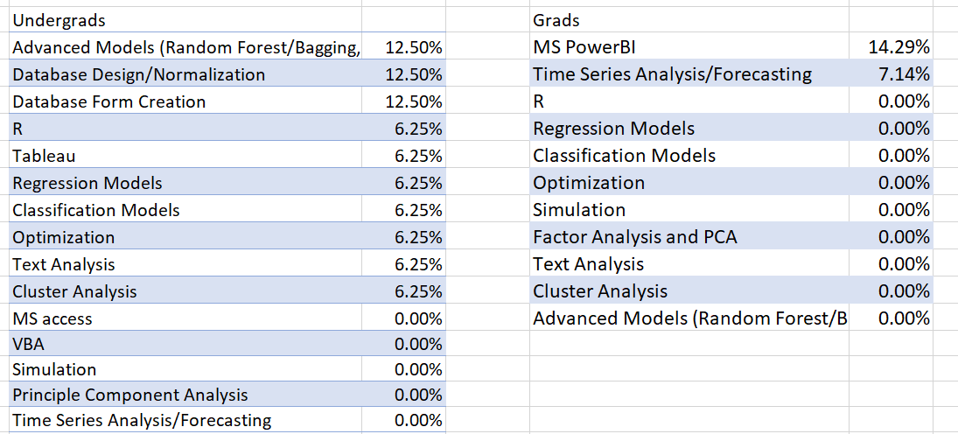
Used Weekly In the Last 6 Months – Bottom

Slide 23


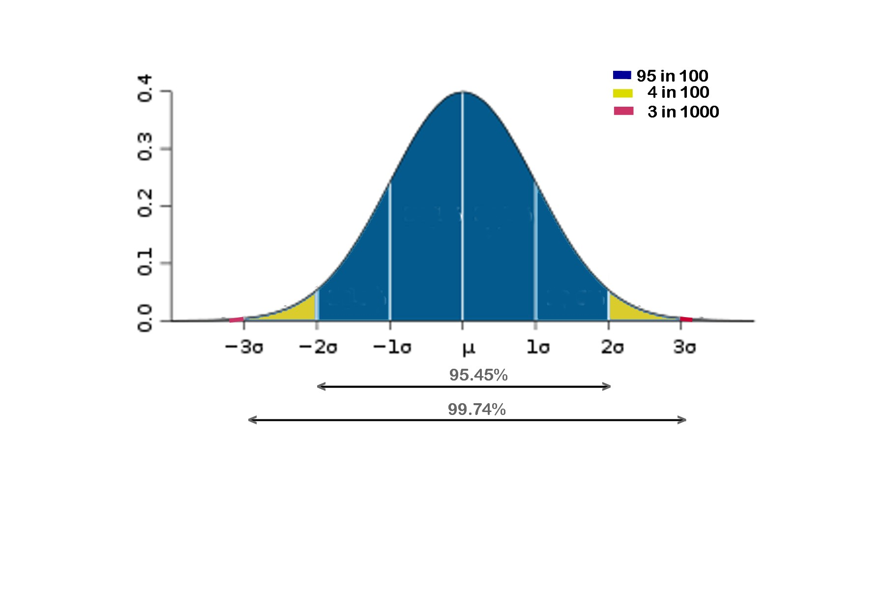

Changes Requested - Combined
Python/More Python – 6
SQL/More SQL – 3
Communication Skills – 2
More Stats – 2
More Cases and Projects – 2
My Favorites: Practice responding to challenges at the end of a presentation
Keep it real – not much modeling in job

Slide 24
Take Aways
We have already made some of the changes
Other things are going to be good to consider
We have similar outcomes and feedback from both undergraduate and graduate students

Slide 25

Stoney@du.edu KKeeling@du.edu
bit.ly/KKPresentationFiles

